Slide 1
Strawsonian Responsibility: 3 Critiques from the margins
Mich Ciurria, author of an intersectional feminist theory of moral responsibility & blogger at biopolitical philosophy

Slide 2
Strawson’s theory of responsibility
Holding someone morally responsible = seeing the person as a proper target of “reactive attitudes,” such as gratitude, resentment, forgiveness, anger, and hurt feelings
Exceptions:
(1) non-neurotypical people
  Strawson says people with “compulsions,” “schizophrenia,” “less extreme forms of psychological disorder”…
(2) young children
(3) other-than-human animals

Slide 3
Why?
These groups lack the capacity to participate in interpersonal relationships and contribute to the “moral community”
Matthew Talbert in the SEP:
For Strawson, the most important group of exempt agents includes those who are, at least for a time, significantly impaired for normal interpersonal relationships. These agents may be children, or psychologically impaired like the “schizophrenic”; they may exhibit “purely compulsive behaviour”, or their minds may have “been systematically perverted” (P. Strawson 1962 [1993: 51]).

Slide 4
Justified by commonsense?
Robin Dembroff: The “pretheoretical concepts and terms” that academic elites find intuitive or self-evident are those of the “culturally powerful,” as opposed to “the commonsense of the racialized, poor, queer, transgender, or disabled,” which are “considered philosophically irrelevant ‘ideology,’ ‘activism,’ or ‘delusion’”

Slide 5
1. Ableism & practice-dependent theories
Strawson: the practice of responsibility “neither calls for, not permits, an external ‘rational’ justification”
Victoria McGeer, as described by Jules Holroyd: “There are facts, at any particular time or in any particular context, about what is fashionable. Something or someone can have the property of being fashionable. But these facts, or possession of the property, are wholly determined by the norms of fashion and by the practices involved in it. There is no independent, objective property that fashion- related practices track”
David Shoemaker: “there simply is no question as to [the responsibility system’s] correctness or incorrectness from an external standpoint.”

Slide 6
Political Liberalism
By discounting ‘external’ criticism, particularly critiques from vastly different cultural standpoints, practice-dependent views seem to restrict social change to incremental reform within the system – that is, piecemeal reforms consistent with the dominant liberal tradition.
McGeer, R. J. Wallace, Michael McKenna, and other moderates: revisions to the cultural definition of responsibility should be “conservative” and “modestly revisionary,” not radical or revolutionary.

Slide 7
Political Radicalism
Charles Mills, Carole Pateman, and Stacy Simplican: the social contract is structurally racist, sexist, ableist, and anti-revolutionary. This liberal approach clashes with the preferred political strategies of Indigenous feminists, crip theorists, and Marxists, who call for revolutionary change from below.

Slide 8
How to resolve conflict?
Holroyd: responsibility theorists must provide “tools for articulating and addressing” oppressive norms in a culture’s responsibility system
Address epistemic injustice, acknowledge asymmetries of power, etc.

Slide 9
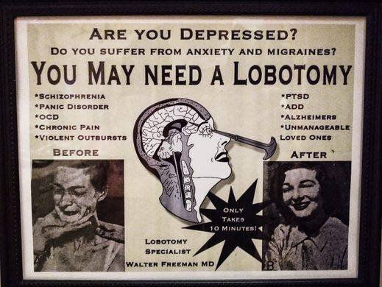
Treatment? Management? Social Policy?
Sadcrips: proper objects of “treatment,” “management,” “training,” and “social policy,” as well as risks to be “avoided” and “taken precautionary account of,” as opposed to members of the moral community
Image: an old advertisement for lobotomies, presented in a vintage medical poster style. It reads, "Are you depressed? Do you suffer from anxiety and migraines? You may need a lobotomy." The poster lists various conditions for which a lobotomy was purportedly a treatment, including schizophrenia, panic disorder, OCD, chronic pain, violent outbursts, PTSD, ADD, Alzheimer's, and being an "unmanageable loved one.”
The last recorded lobotomy in the United States was performed by Dr. Walter Freeman in 1967 and ended in the death of the person on whom it was performed.

Slide 10
Franfurtian thought experiments
Armchair speculations
Are addicts mad or bad? Deserving of punishment or treatment?
Addiction and disability are not fodder for thought experiments & abstract case studies

Slide 11
2. other-than-human animals
South Asian Philosophy
Indigenous environmental feminisms
Non-anthropocentric, include non-human animals in scope of responsibility

Slide 12
3. Children/youths
Eva Feder Kittay: the exclusion of “profoundly cognitively disabled” individuals from the definition of moral personhood, and by extension moral responsibility, is “as morally repugnant as earlier exclusions based on sex, race, and physical ability.”
Licia Carlson: treating intellectual disability as a limiting or “marginal case” of personhood is deeply ableist.
The Journal of Qualitative Health Research: “personhood is not related to functional or physical capabilities,” and “acknowledgement of personhood is critically important for people with disability, who have historically been denied basic human rights… through erasure of their role as decision-makers with authority over their own lives.”

Slide 13

The Youth Rights/Liberation Movement
Image: “National Youth Rights Association” in bold blue, navy, and orange font

